Slide 1

TEAM ASSIGNMENT 3
Software Measurement and Analysis
Team : K15T1_Team11
Project Name: Course SMA

Slide 2

TEAM 11
Le Dinh Thach Huyen (Member)
Dang Huy Son (Sub-Leader)
Do Minh Tam (Member, Recorder)
Nguyen Trung Tin (Member)
Le Thi Bich Van (Leader)

Slide 3

CONTENTS
GQM – Reduced the schedule by 10%
Team Effort Log Week 3
Notes:
Overview What we measured?

Slide 4
1. GQM – Reduced the schedule by 10%
Question | Question level 2 | Metrics
1. How to know current status of progress? | How much time will you spend? How many tasks in the schedule? How much time will you spend for each task? How many tasks has finished? How much time has used until now? | Rate complete = Total task finished / Total task on plan 2. Current position of schedule = time on plan*90% – time used until now 3. Necessary effort = CPS / number of unfinished task
Notes:
Data collection: Source: Description:
1. Total hour on plan Plan - WBS 1. Help PM know assigned tasks in schedule.
2. Total task on plan Plan - WBS 2. Help you measure progress of schedule.
3. Hour spent for a task Plan - WBS
4. Total finished task Project tracking spreadsheet
5. Total time used Project tracking spreadsheet

Slide 5
1. GQM – Reduced the schedule by 10%
Question | Question level 2 | Metrics
1. How to know working performance? | How much time for a team to complete a task in actual? How much time will you spend for each task ? | Performance of team
Notes:
Data collection: Source: Description:
1. Hour to complete a task on actual Project tracking spreadsheet 1. Help PM evaluate performance and effort of team
2. Hour spent for a task Plan - WBS

Slide 6
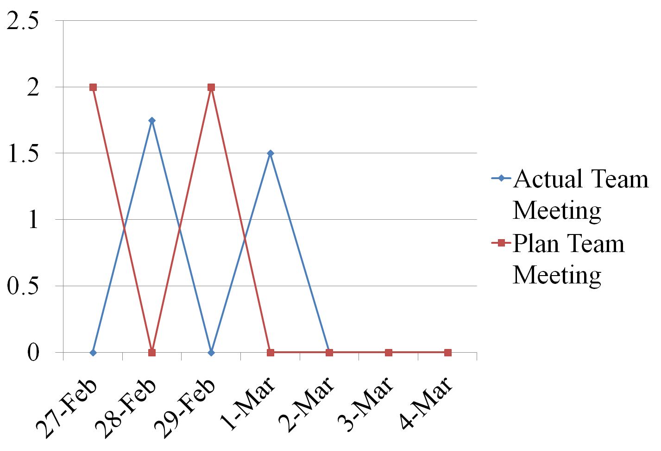
2. Team Effort Log – Week 3
Notes:
Comment here !!

Slide 7
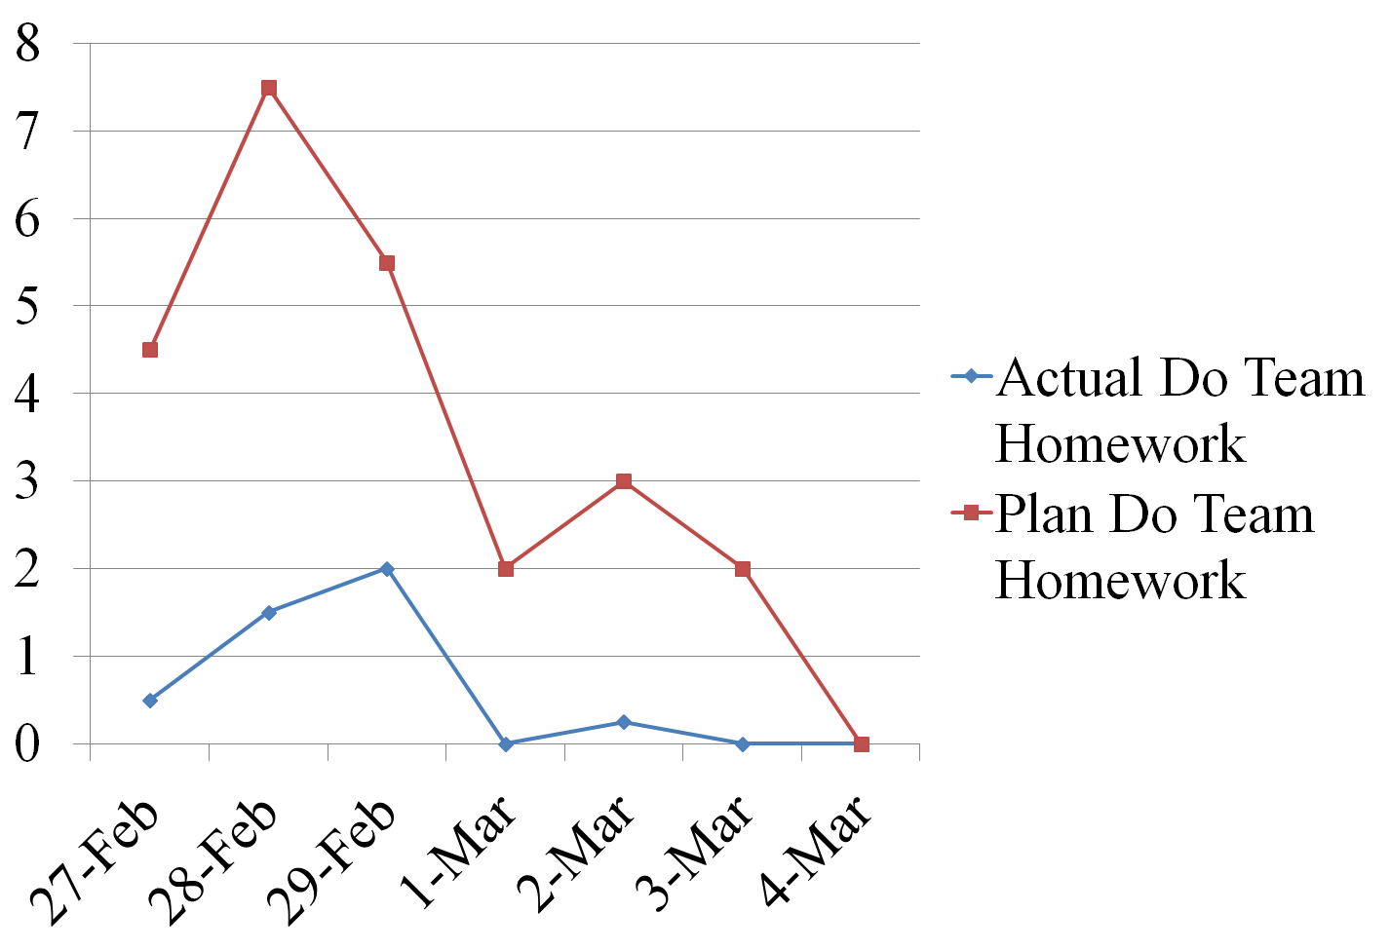
2. Team Effort Log – Week 3
Notes:
Comment here !!

Slide 8




